Slide 1
Music Player Clone
Team Number-18
Drishti Bhardwaj (2210990306)
Gautam Nagpal (2210990321)
Geetanshu Mantro (2210990324)
22CS016

Slide 2
Index
Objective
Introduction
Methodology, Approach & Techniques
Algorithm
Flow Chart
Result
Source Code (screenshots)
Conclusion
Reference
22CS016

Slide 3
Objective
To create a Spotify Web clone using HTML/CSS
To use JavaScript to make the website functioning
To learn web development by recreating a popular website
To showcase and learn from this opportunity to make a project

Slide 4
Introduction
This project is a web music player, designed using HTML, CSS and JavaScript, and can play limited songs as visible on the home page playlists.
This web page enables listening to music by simply clicking the song to play, from different playlists as visible on the home page.

Slide 5
Methodology, Approach & Techniques
The framework for the web page was done using HTML, using div tags to create the card for the playlists, to make containers for the menu bar, to inscribe content at the the head of the page, inscribing logos/icons, using other various tags to set the class, the play bar, the compiled songs list etc.
To manage the size and the placement of the containers as well as the background colours visible on the page, CSS was put to use, setting width, colour, position, gaps, paddings and fonts of the content on the page.
Javascript was used to make the music player, that is, the algorithm to play music on one click, the audio files were uploaded in the project folder, javascript codes were used to access these files, and to handle the working of the player to play the song, or the next song, or the previous songs by using event functions which get triggered on click by the user.

Slide 6
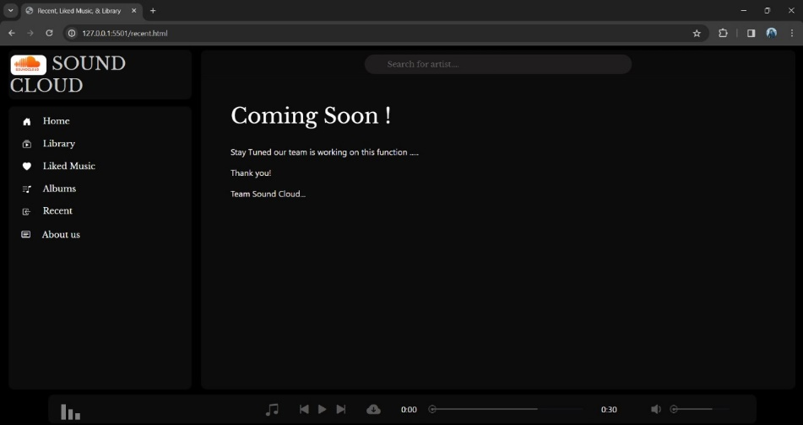
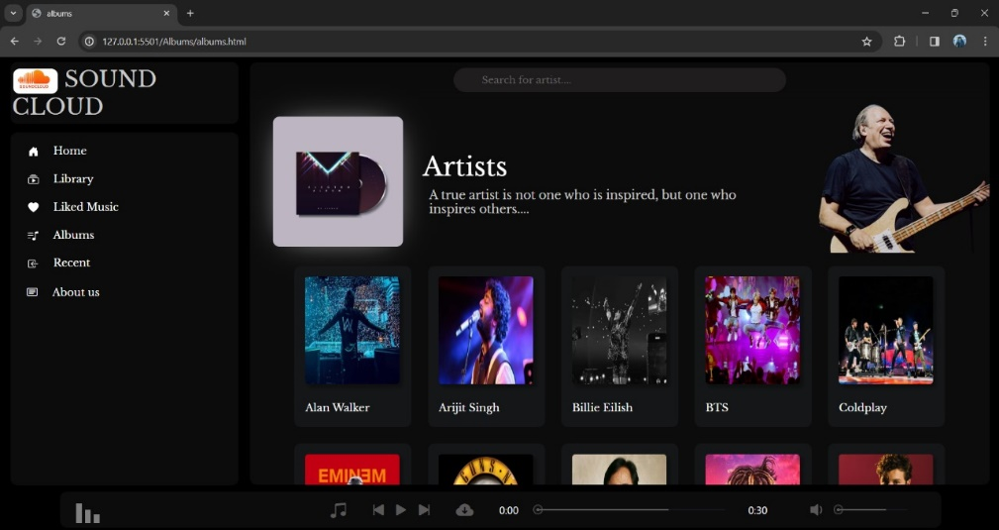
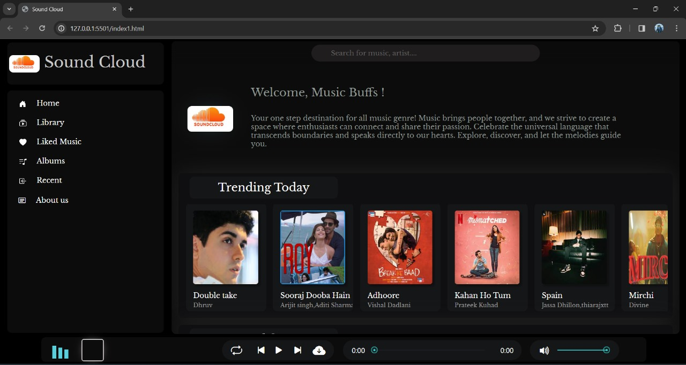
Snapshots

Slide 7
Result
We successfully created a music player using HTML,CSS and JavaScript that plays and pauses as per our liking.
We were able to polish our skills and learn because of this project.

Slide 8
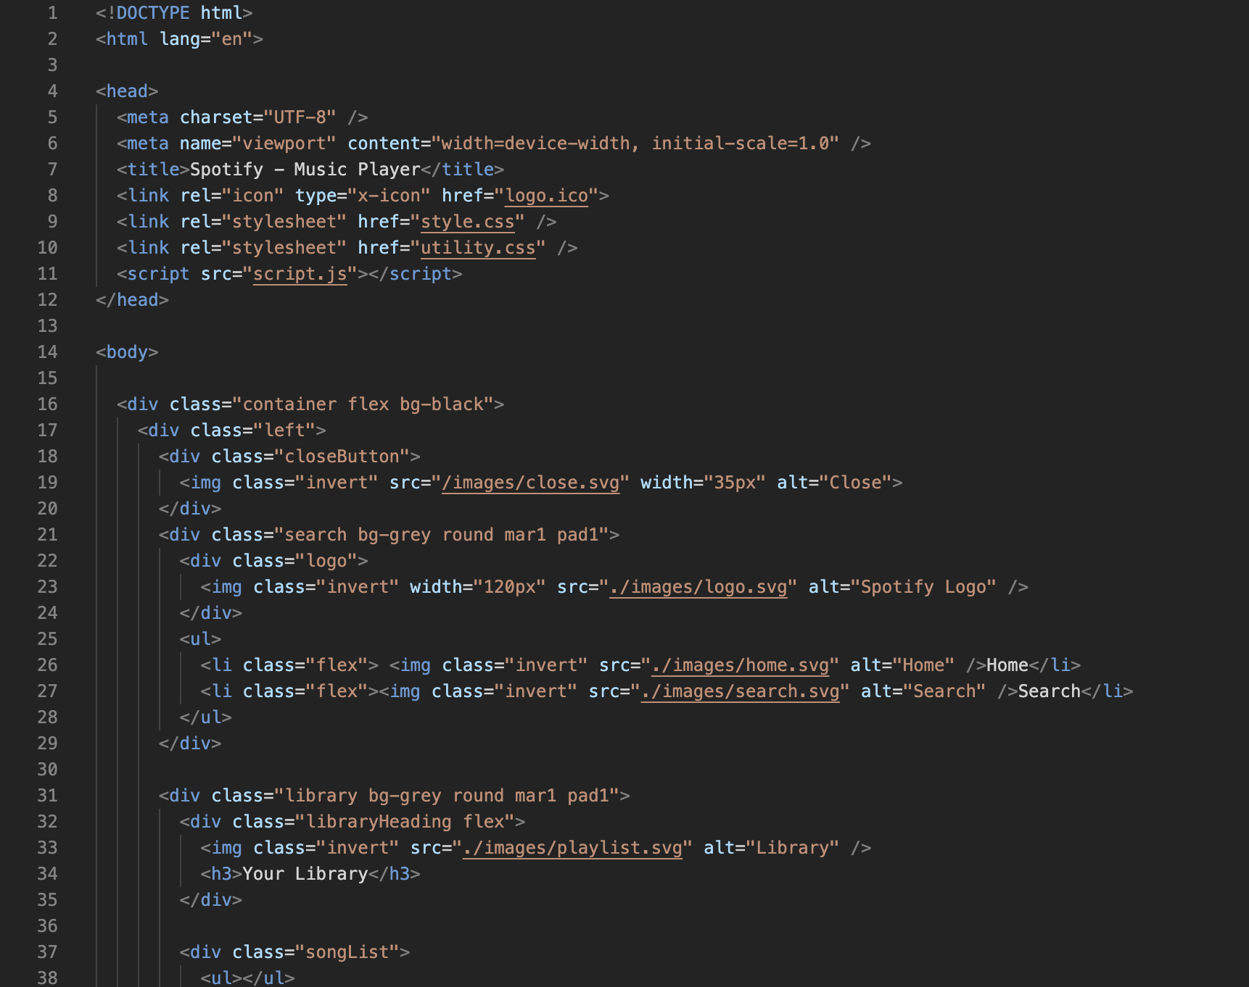
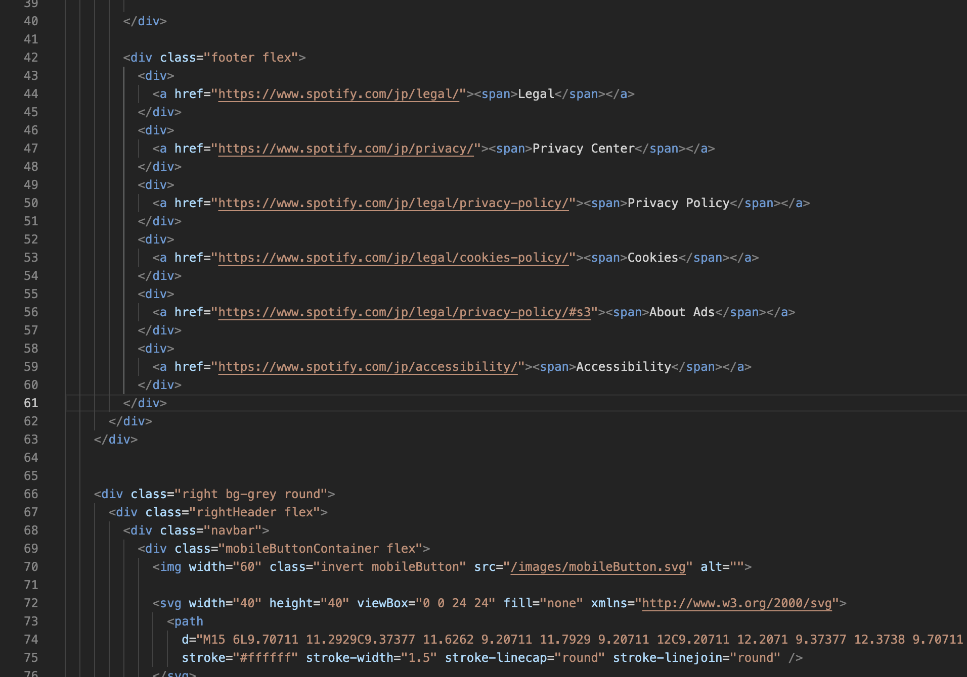
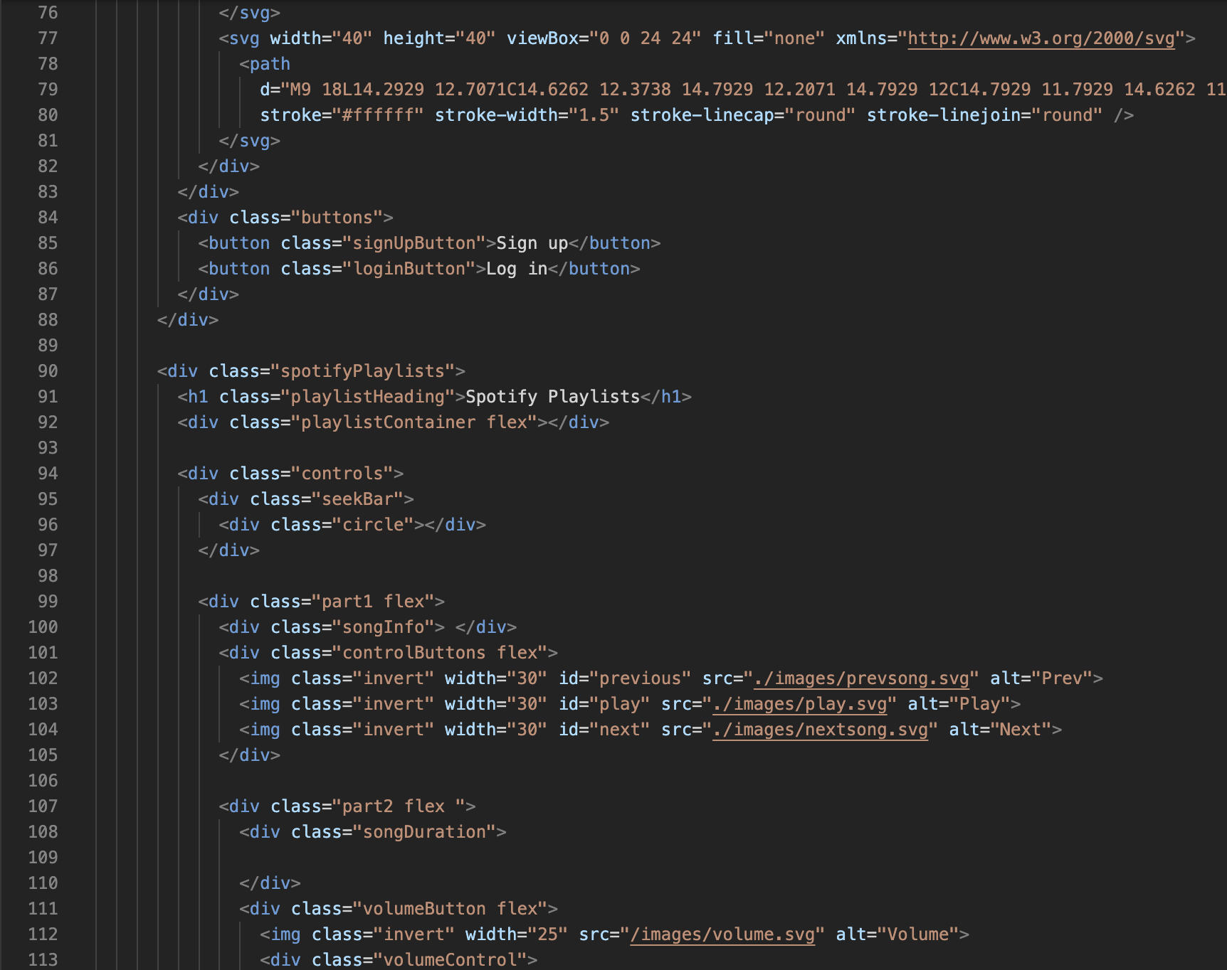
Source Code
HTML code for the project

Slide 9
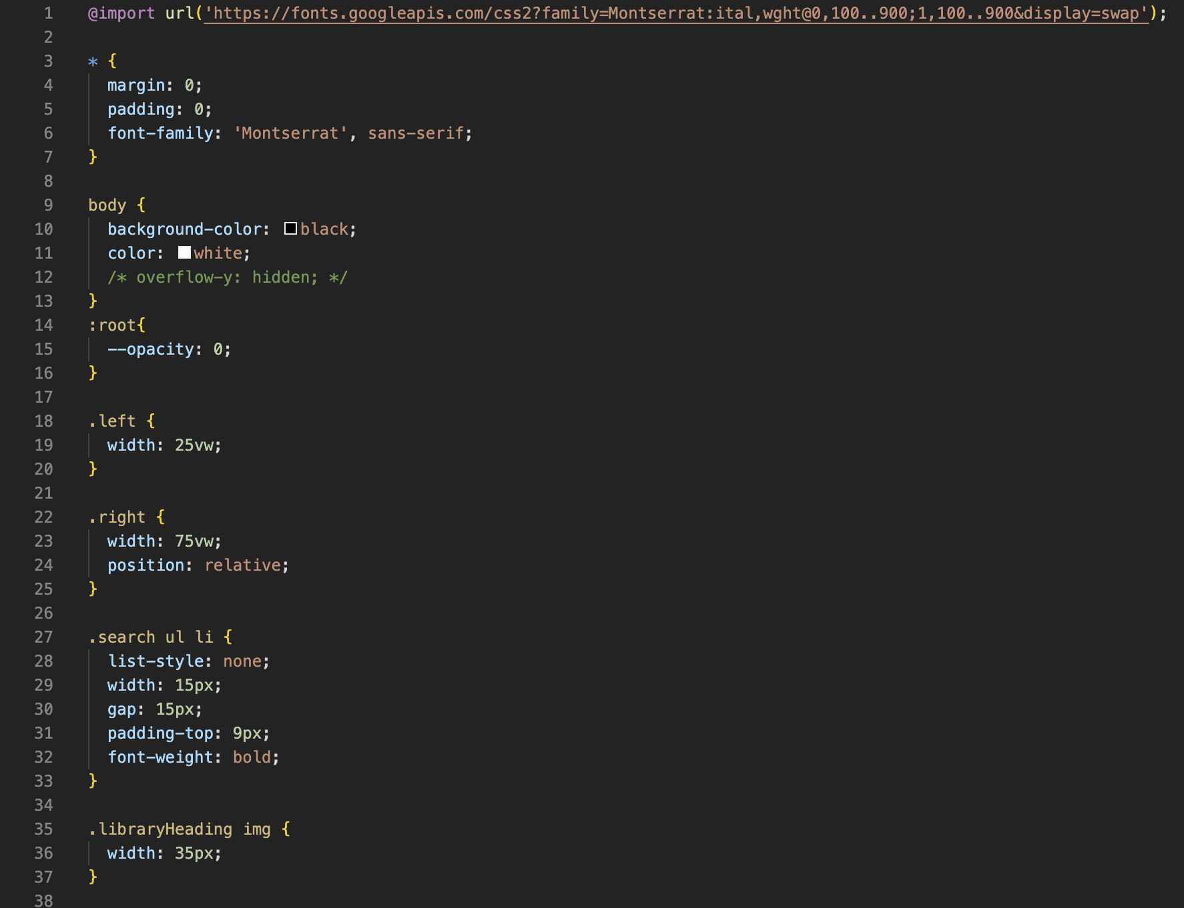
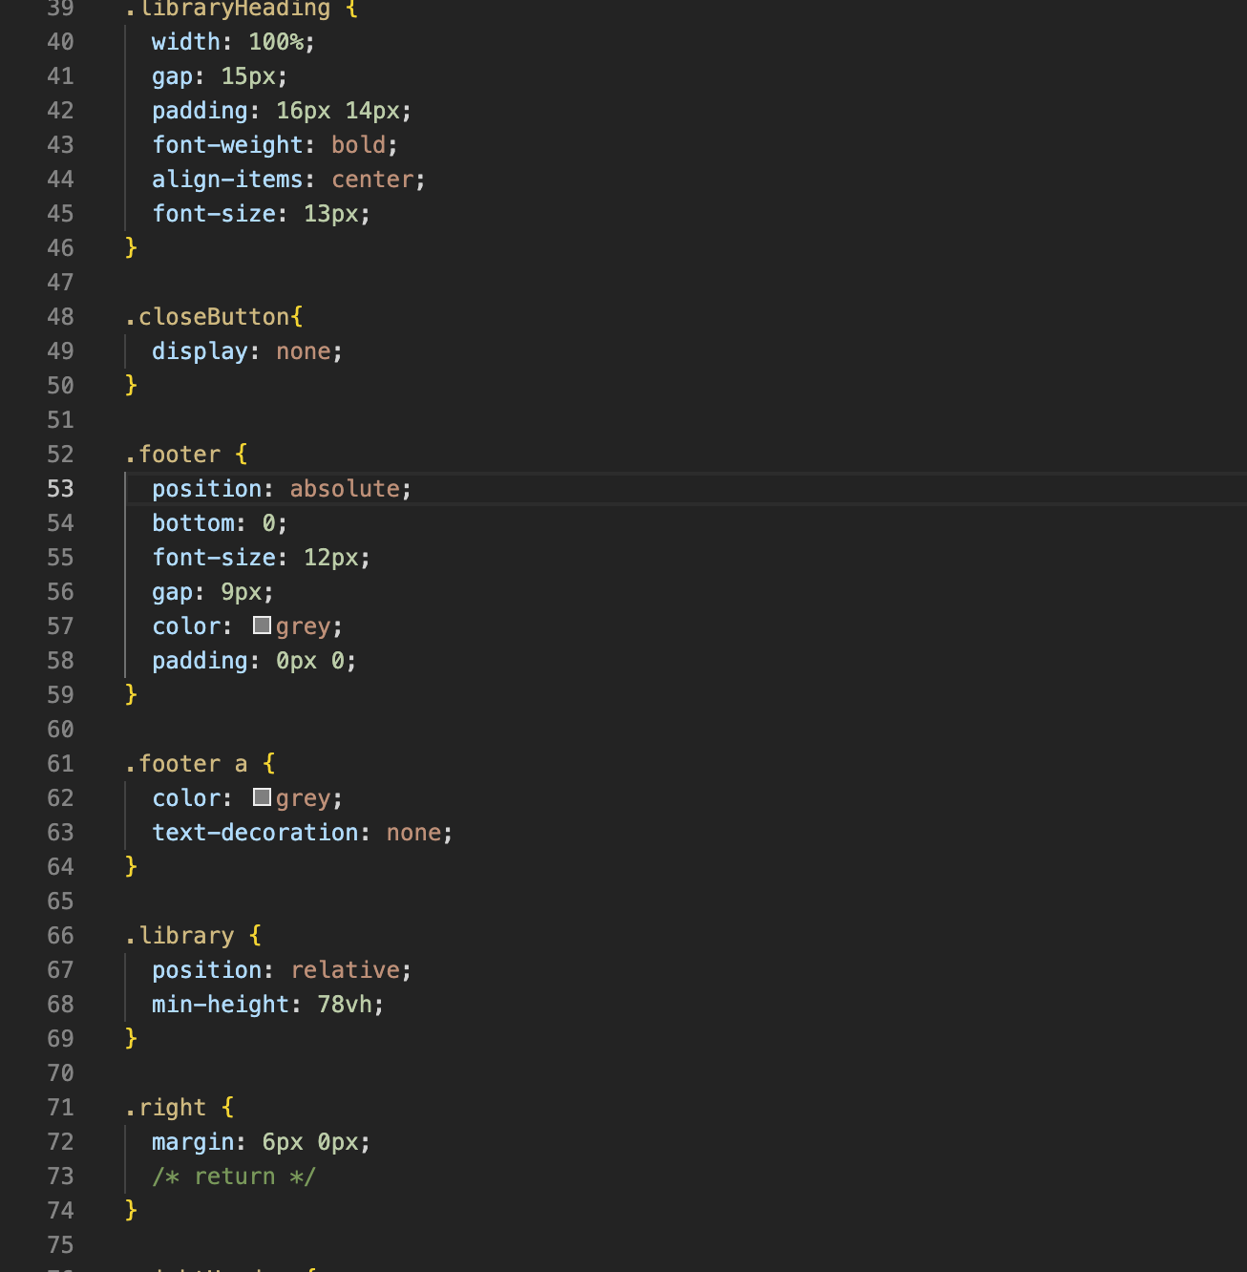
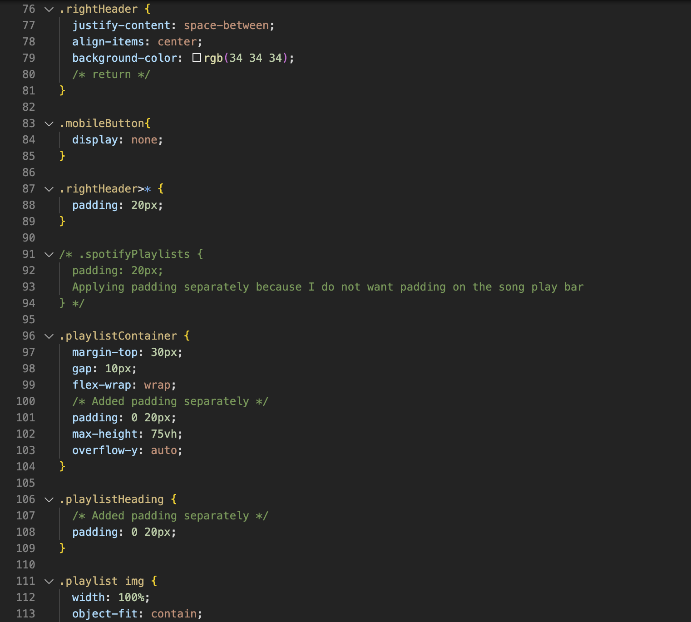
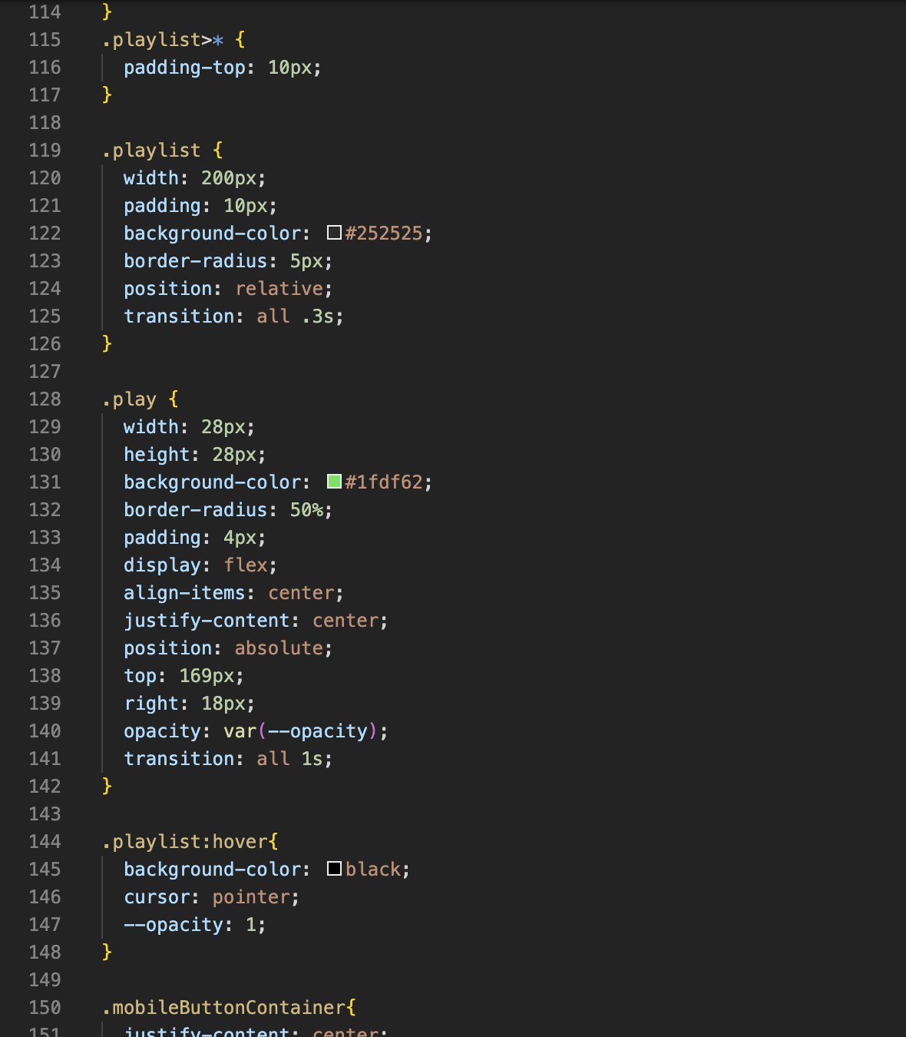
Source Code
CSS code for the project

Slide 10
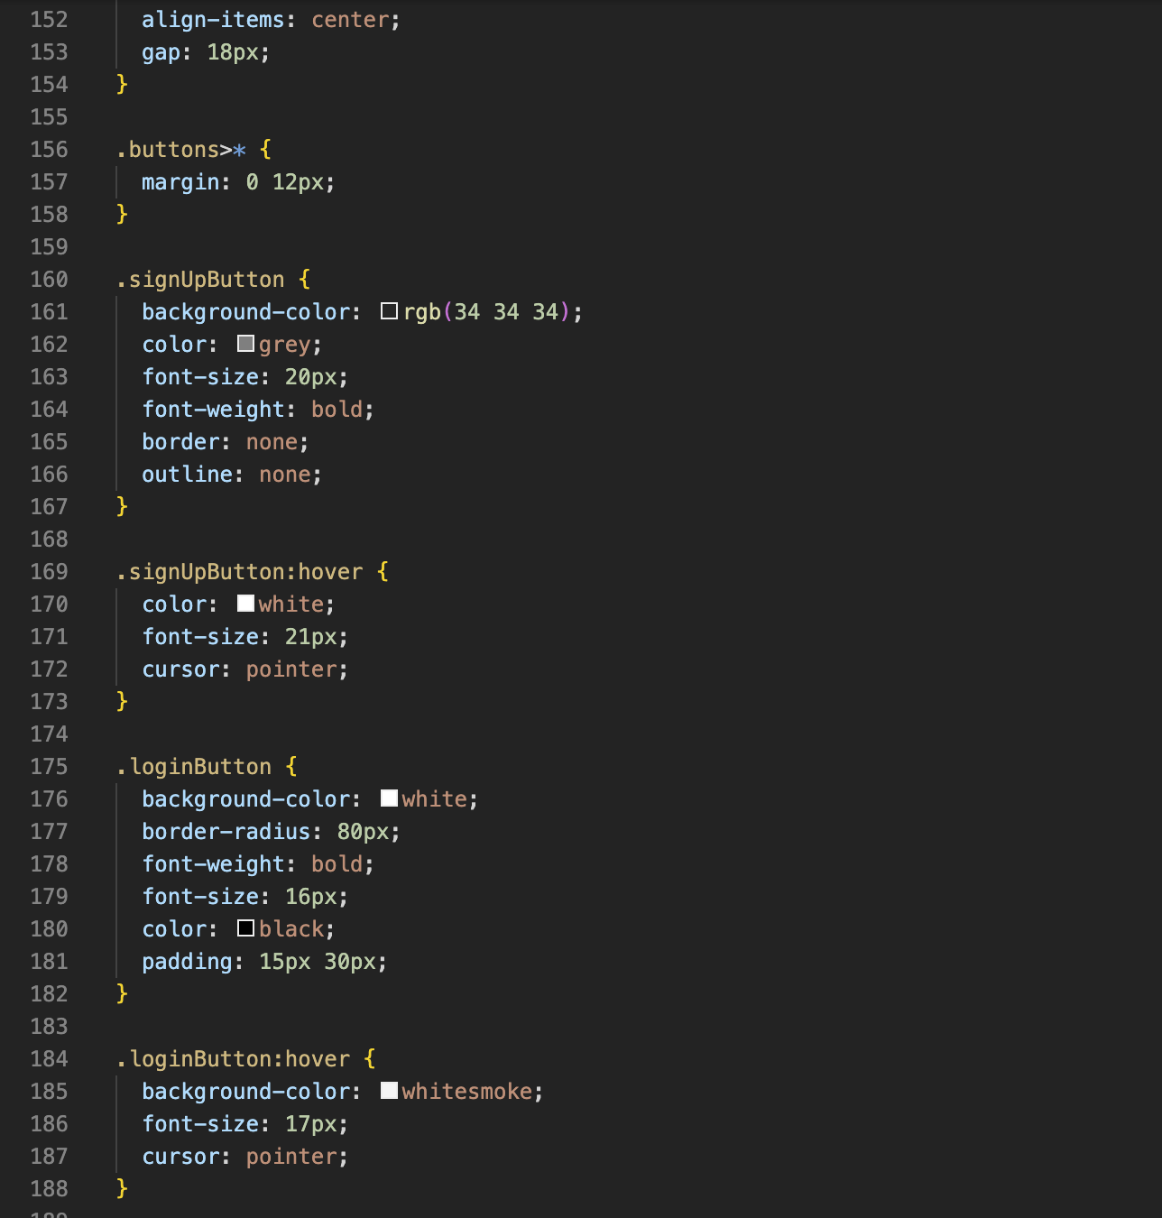
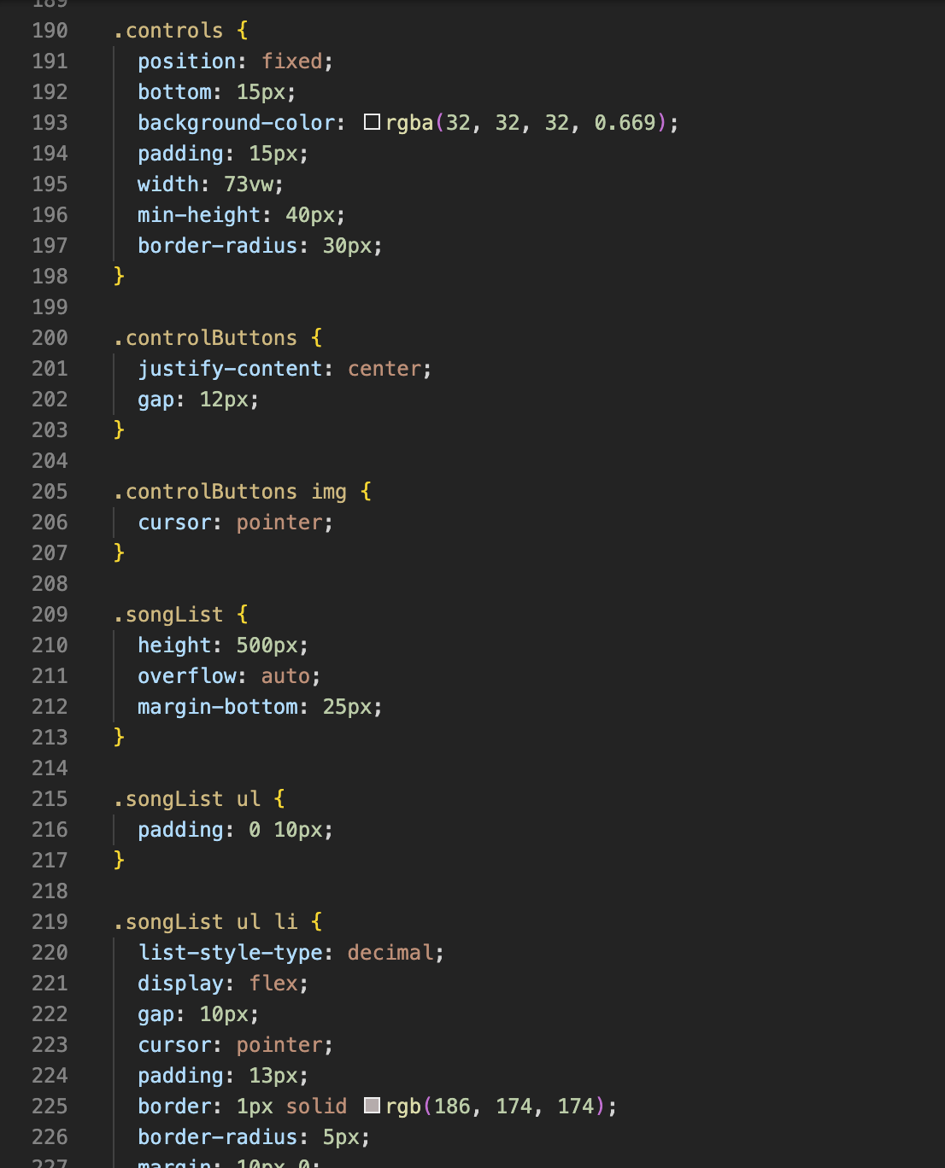
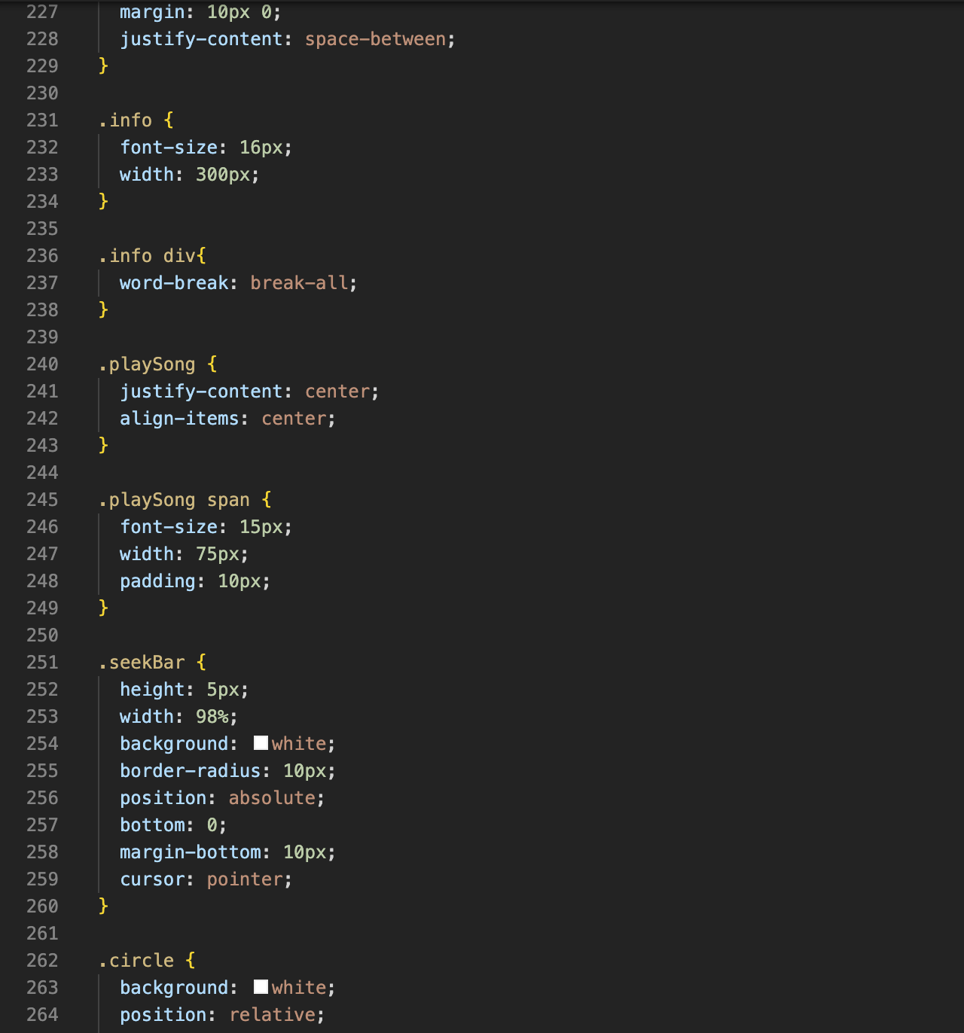
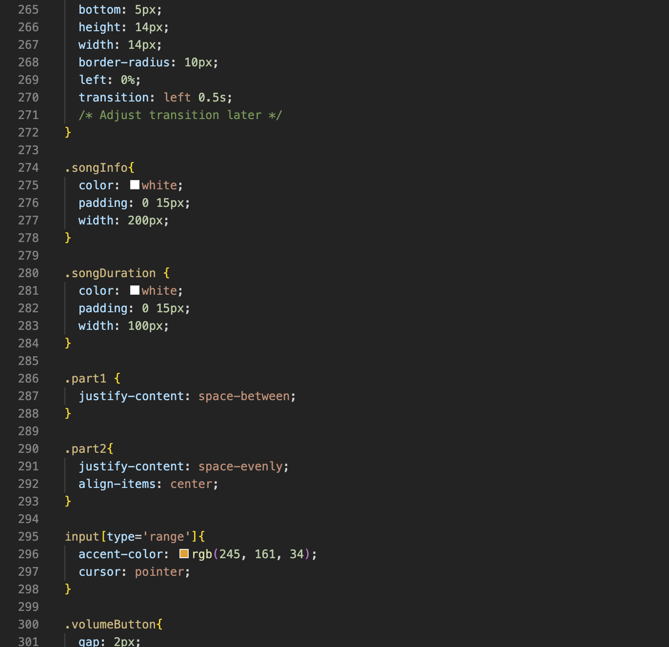
Source Code

Slide 11
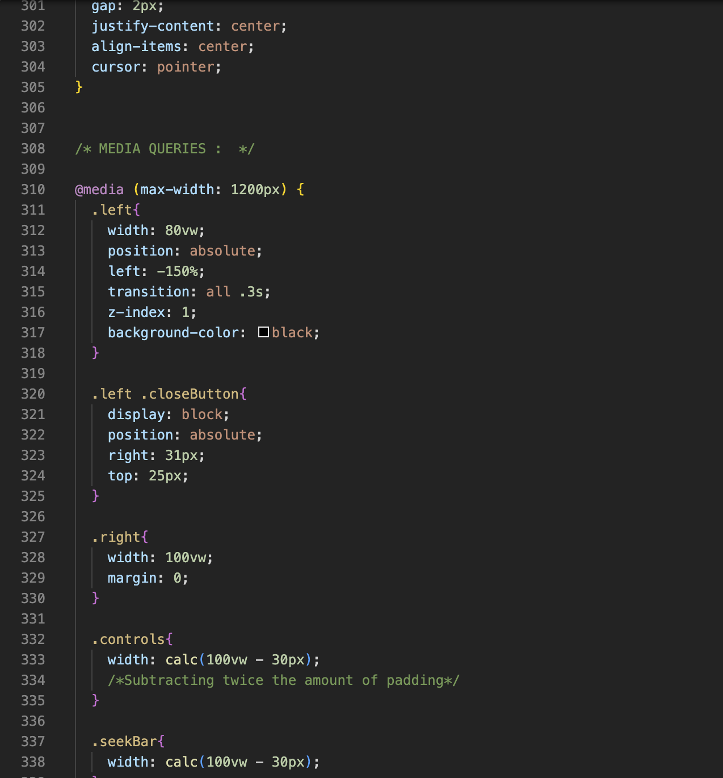
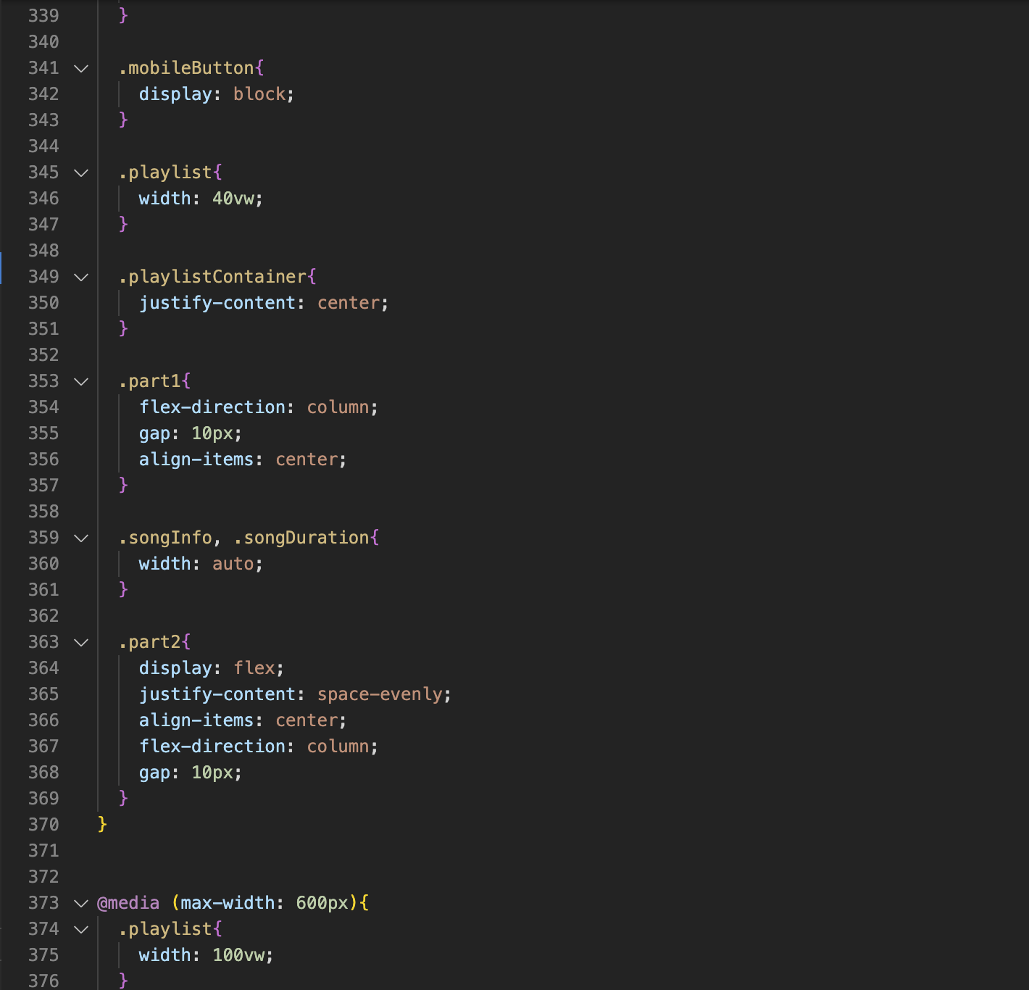
Source Code

Slide 12
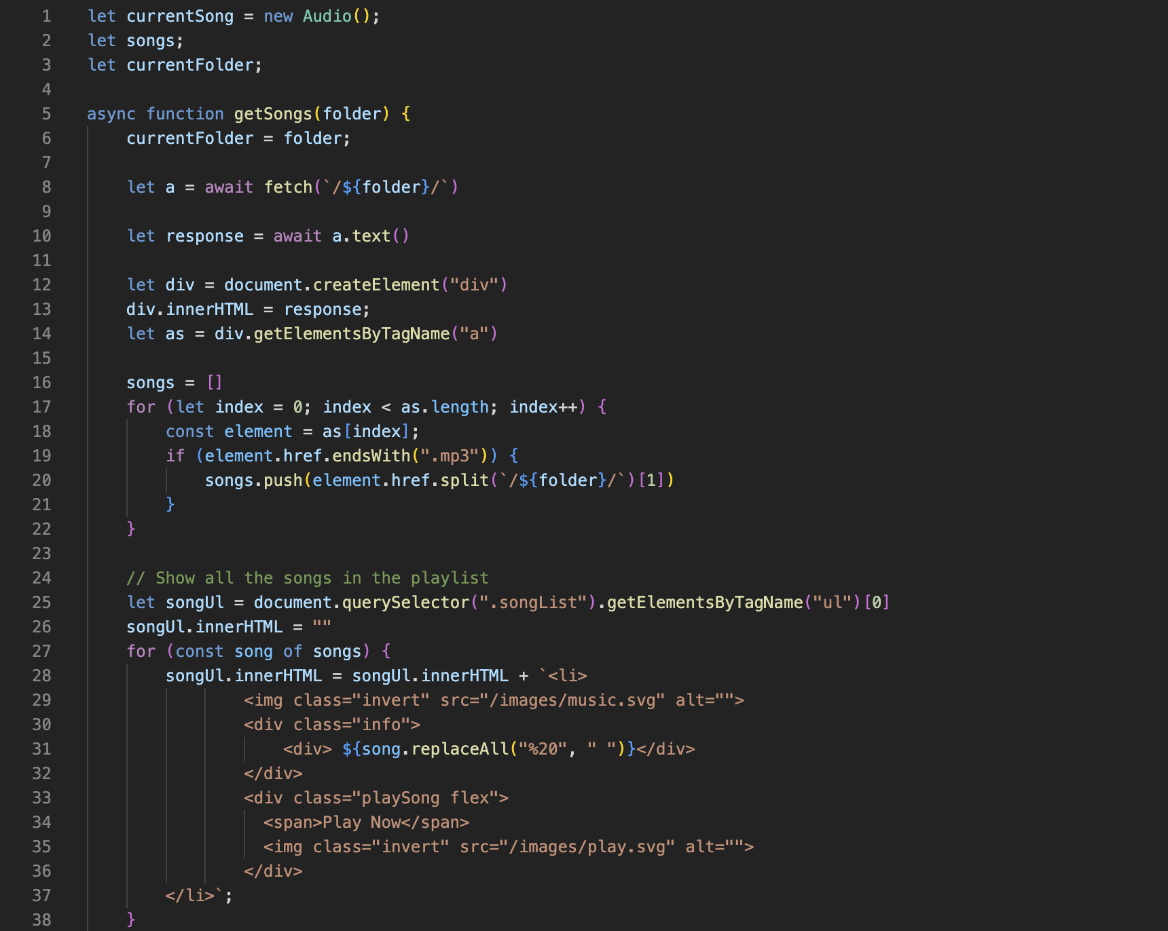
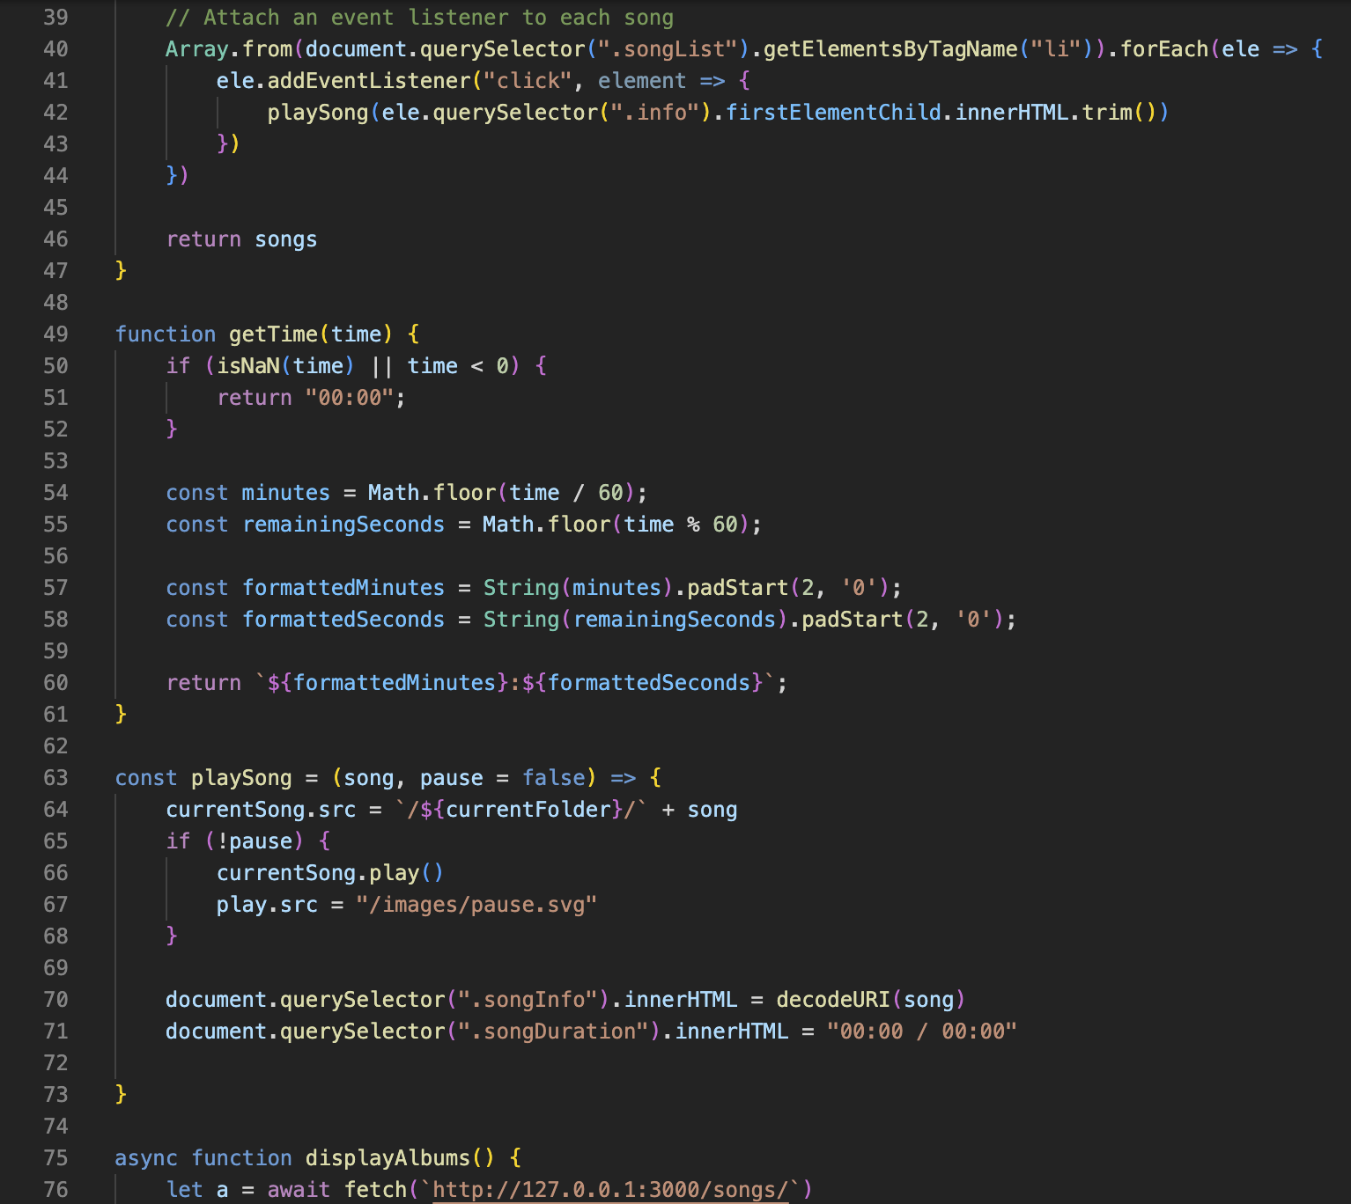
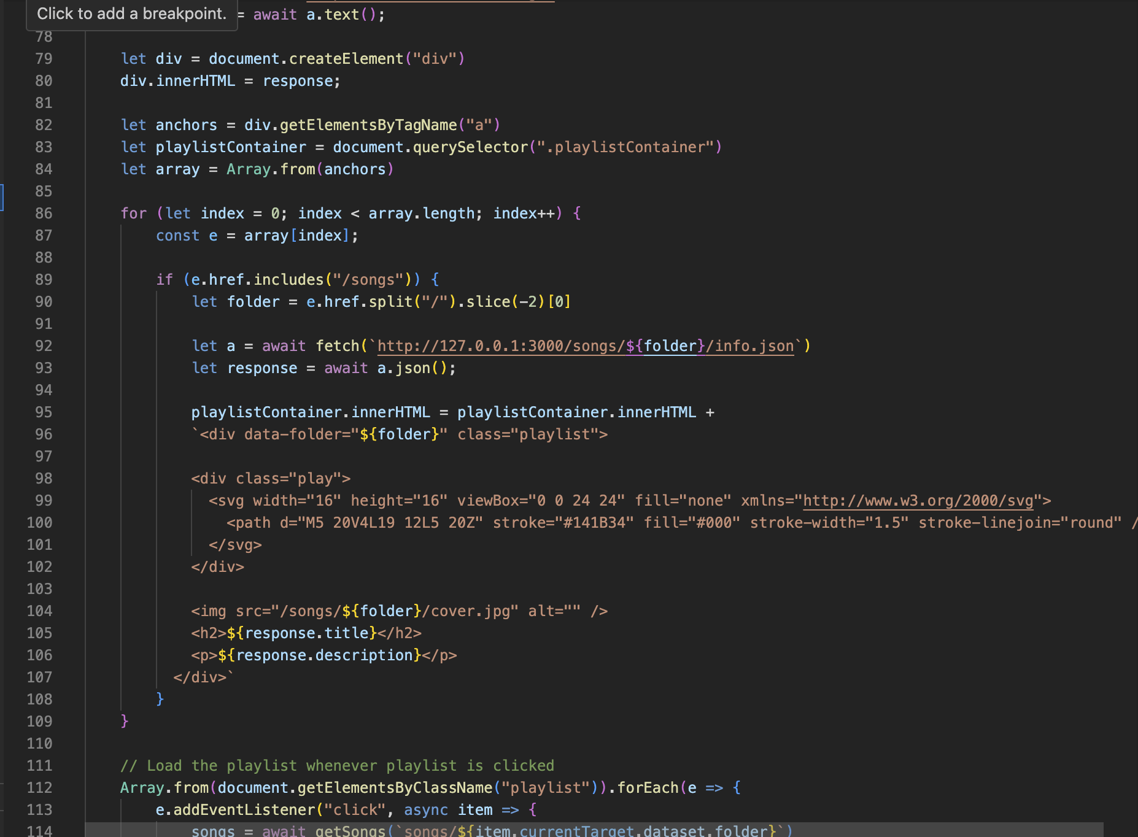
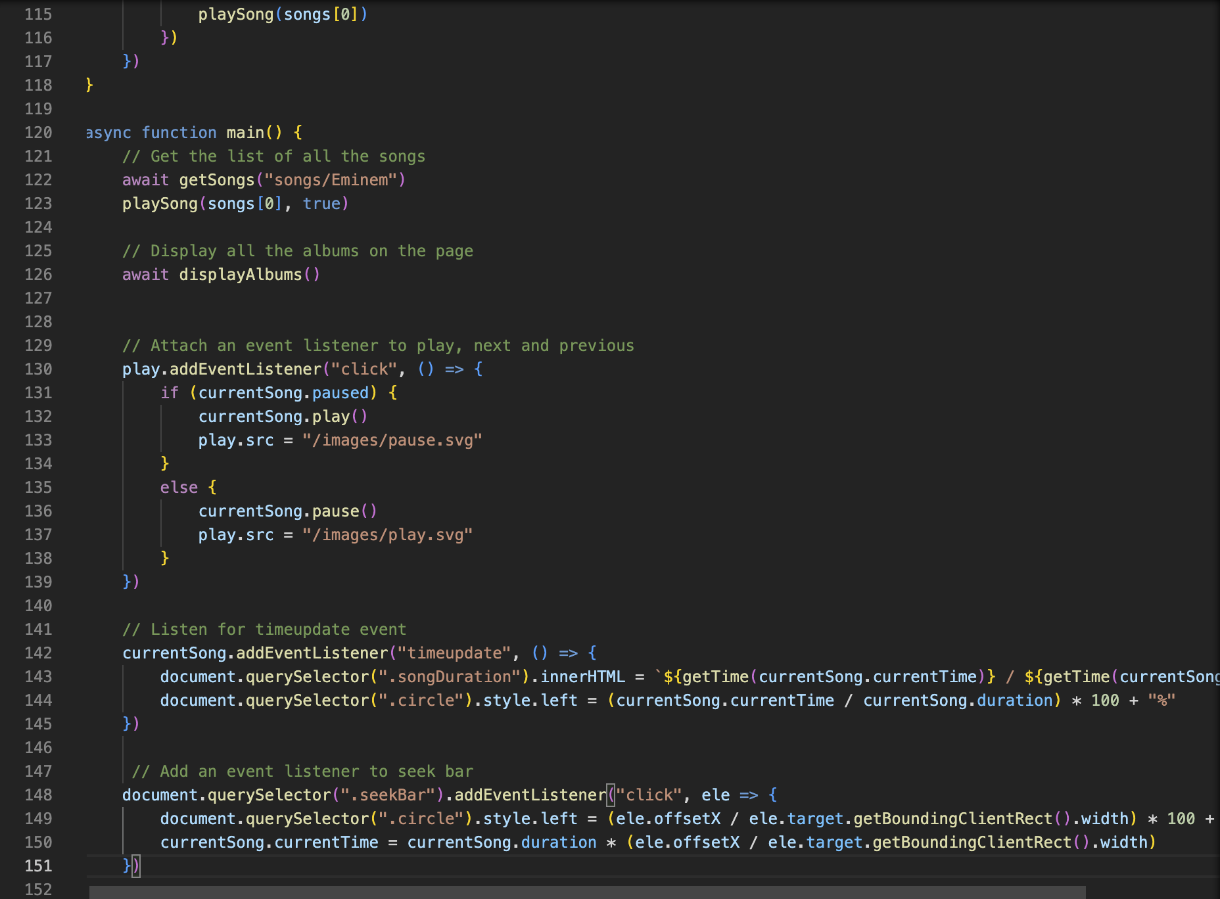
Source Code
JavaScript code for the project

Slide 13
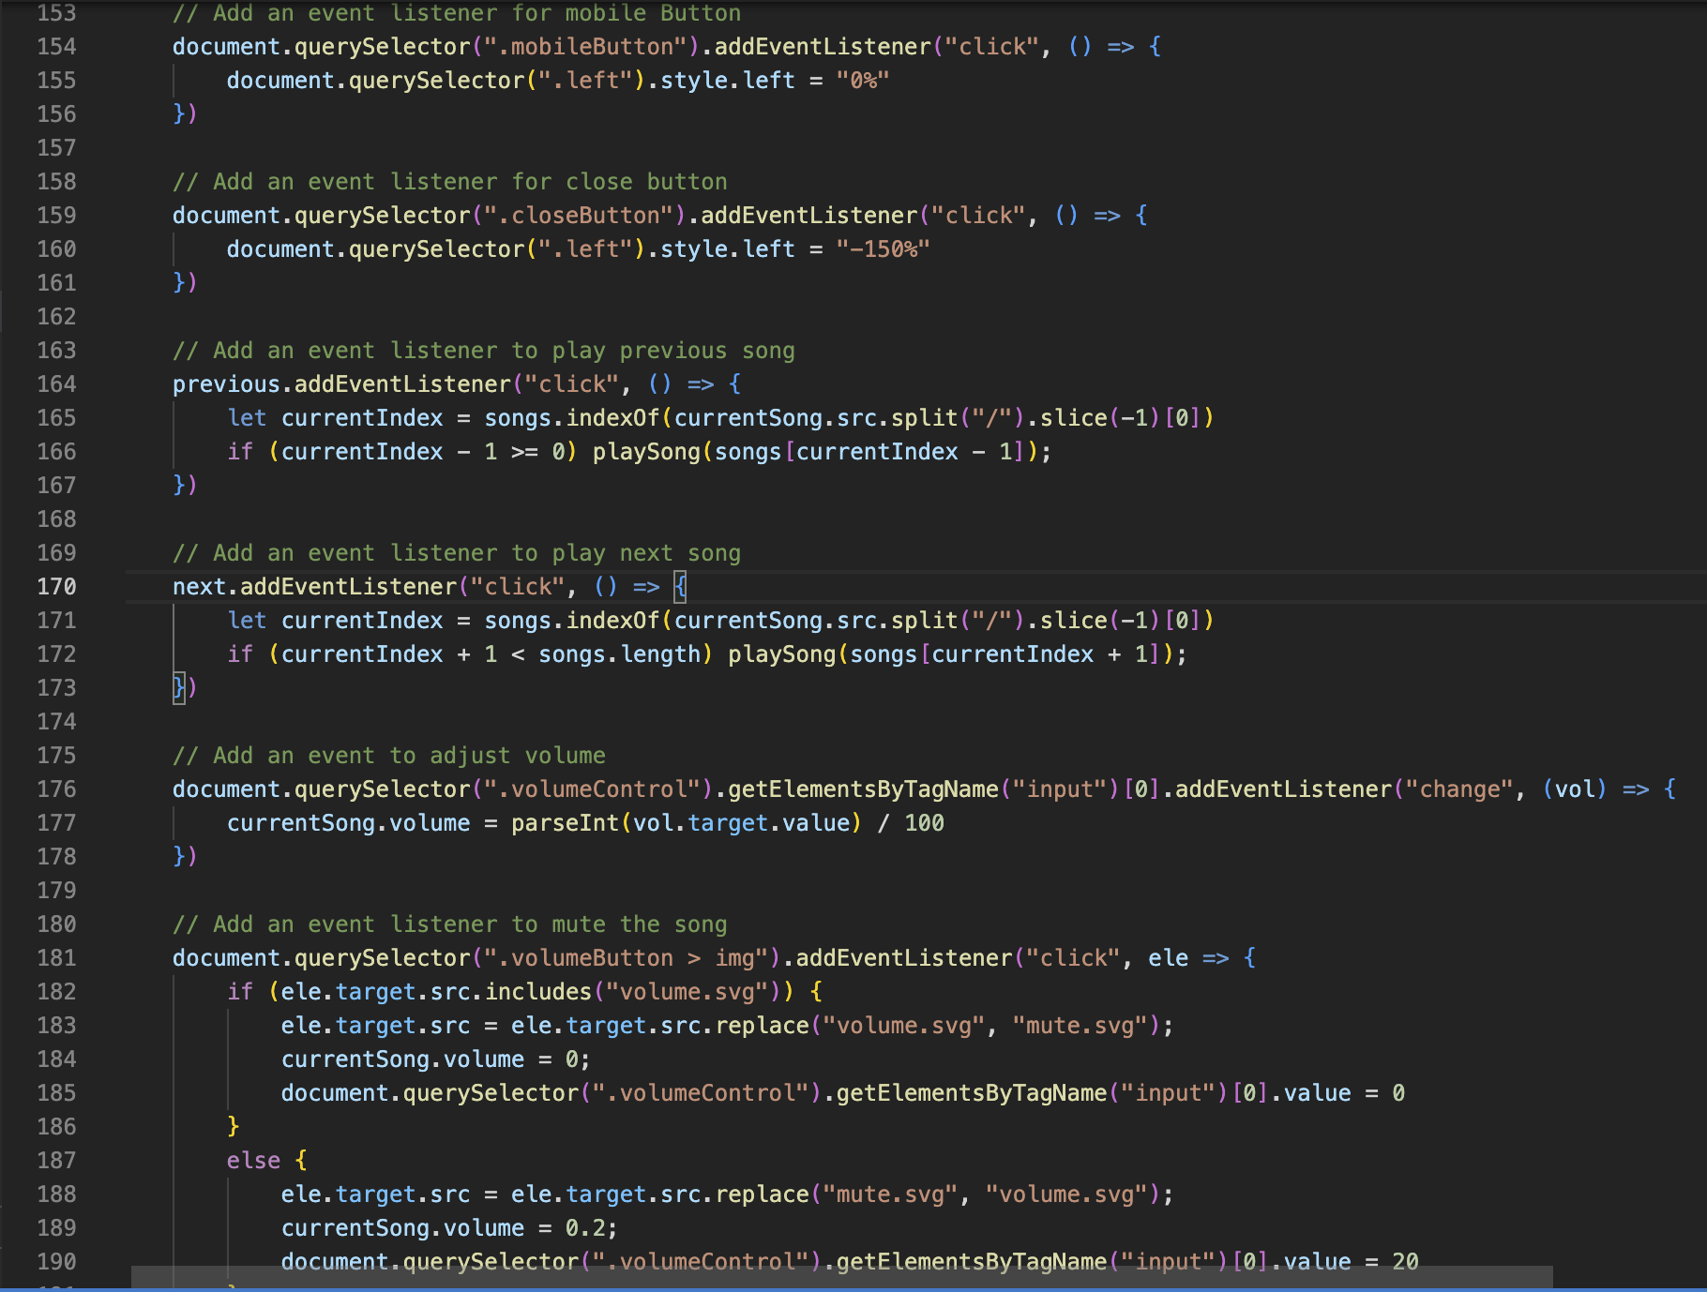
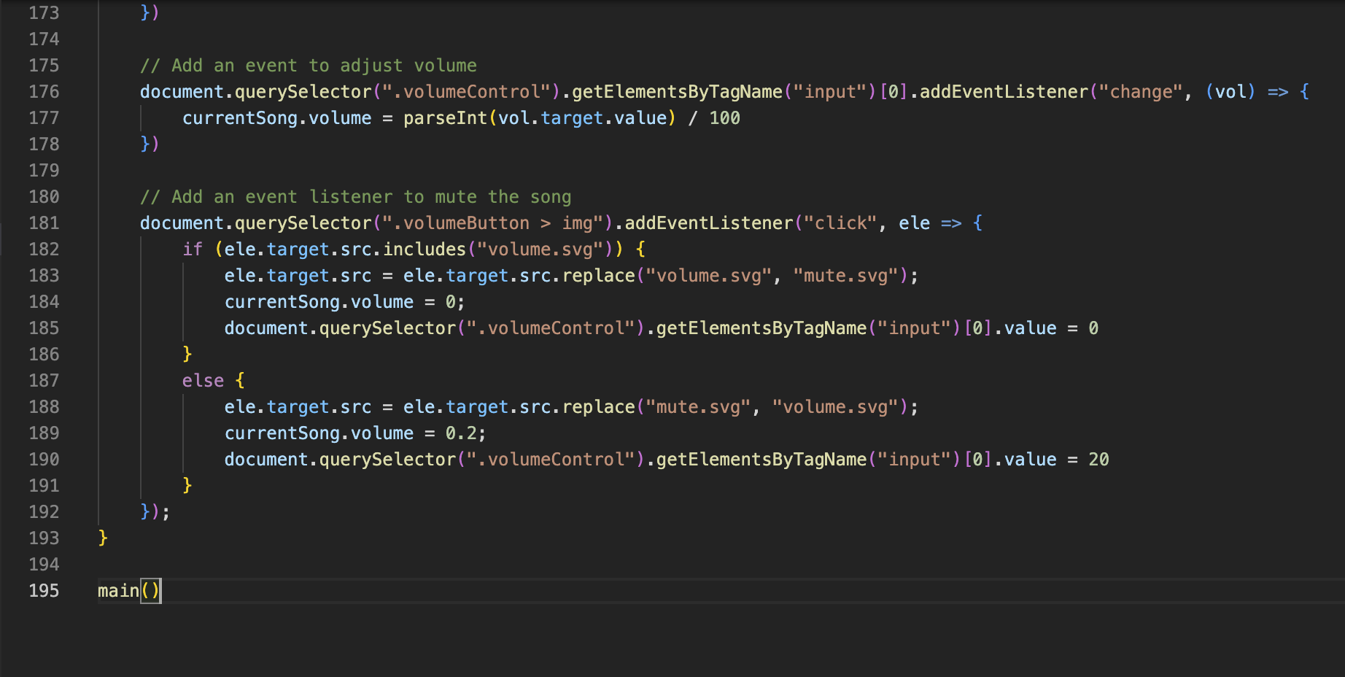
Source Code

Slide 14
Conclusion
The music player successfully functions and works to play music on click and other functions work as needed.
We were able to learn, polish our skills, use javascript, learn the functioning offered by javascript to make a great web page.

Slide 15
Reference
google.com
wikipedia.com
spotify.com
YouTube.com
22CS016

Slide 16

Thenkeww:)<3 :)
22CS016

